Slide 1

COP 6731: Theory and Implementation of Database Systems
Query Processing and Optimization

Slide 2
Outline
Goal:
Understand the best possible strategy for query evaluation

Slide 3
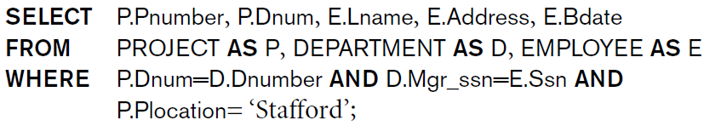
SQL to Relational Algebra

Slide 4
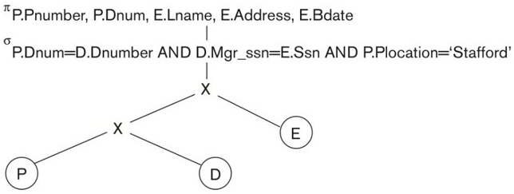
Query Tree

Slide 5
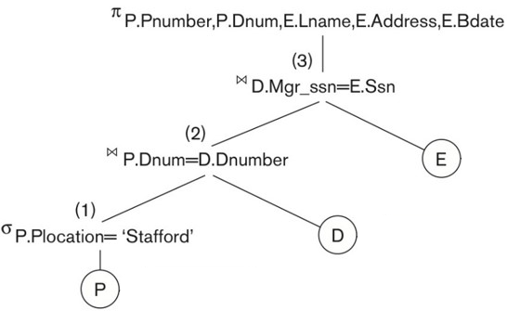
Query Tree

Slide 6
Query Optimization
Sailor (s-id, s-name, rating, age)
Boat (b-id, b-name, color)
Reserve (s-id, b-id, day)
SELECT S.s-name
FROM Reserve R, Sailor S
WHERE R.s-id = S.s-id
AND R.bid = 100
AND S.rating > 5
π_{s-name}(σ_{bid=100 and rating>5} (Reserve ⋈_{s-id=s-id} Sailor))

Slide 7
Pipeline (Stream)
Materialized Evaluation
Evaluating a query by creating and storing each temporary result into the disk and then passing it as an argument for the next operator.
Pipelined evaluation
Combining several operations into one to avoid the writing of temporary results to disk.
On the fly
Results become the input of unary operator (e.g., selection or projection)

Slide 8
Pipeline (Stream)
π_{s-name}
on the fly
σ_{bid=100 and rating > 5}
on the fly
⋈_{s-id=s-id}
Block nested-loop join
Reserve
Sailor
file scan
file scan

Slide 9
Pipeline (Stream)
⋈_{b-id=b-id}
Index nested-loop join
with pipelining
pipeline
Boat
Index
⋈_{s-id=s-id}
Index nested-loop join with pipelining
Reserve
Sailor
File scan
Index

Slide 10
Pushing Selection
π_{s-name}
⋈_{s-id=s-id}
Sort merge join
write
write
σ_{bid=100}
σ_{rating>5}
Reserve
Sailor
File scan
File scan

Slide 11
Using Index
π_{s-name}
σ_{rating>5}
⋈_{s-id=s-id}
pipeline
Index nested-loop join
with pipelining
σ_{bid=100}
Sailor
Hash index
Reserve
file scan

Slide 12
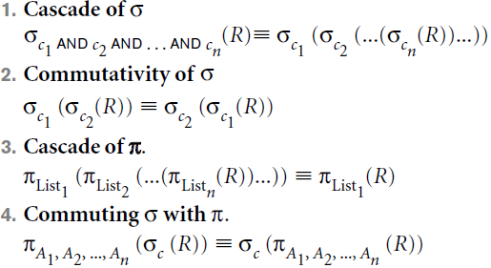
Transformation Rules for RA Operations

Slide 13
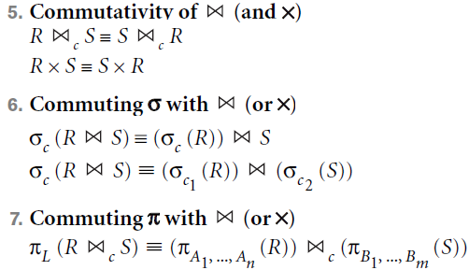
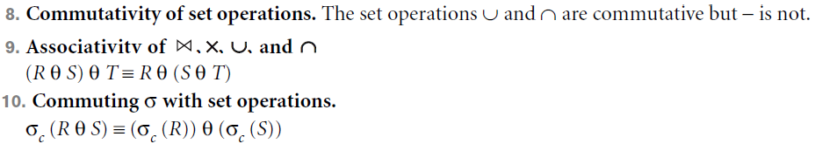
Transformation Rules for RA Operations

Slide 14
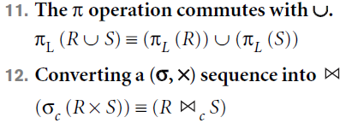

Transformation Rules for RA Operations

Slide 15
Heuristic Algebraic Optimization Algorithm
Break up any SELECT operations with conjunctive conditions into a cascade of SELECT operations.
Pushing down SELECT operations from higher levels.
Position the leaf node relations with the most restrictive SELECT operations (i.e., smallest selectivity)
Avoid Cartesian Product (i.e., Use Join operation)
Pushing down PROJECT operations from higher levels.
Identify subtrees that represent groups of operations that can be executed by a single algorithm

Slide 16
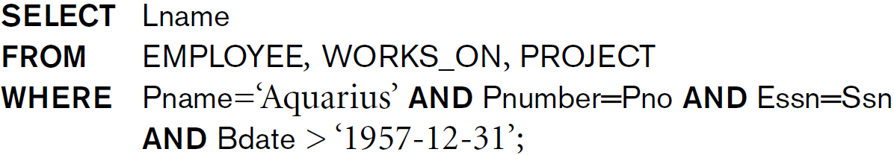
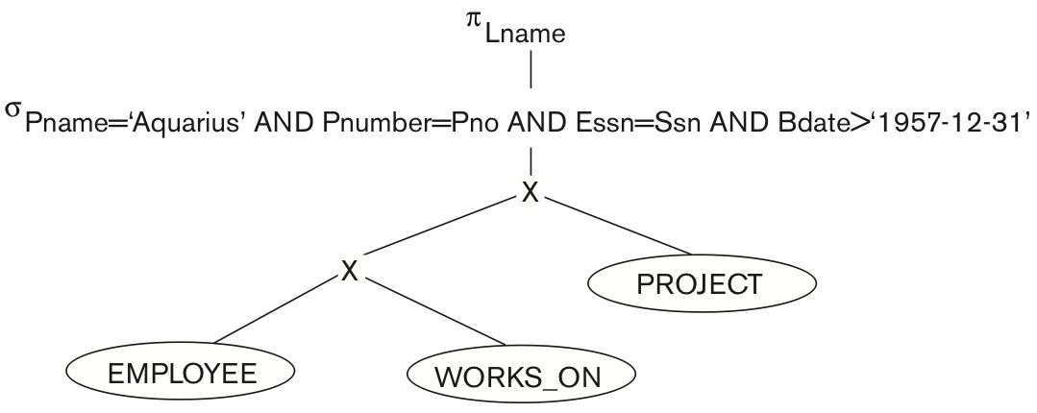
Example of Transforming a Query

Slide 17
Example of Transforming a Query

Slide 18
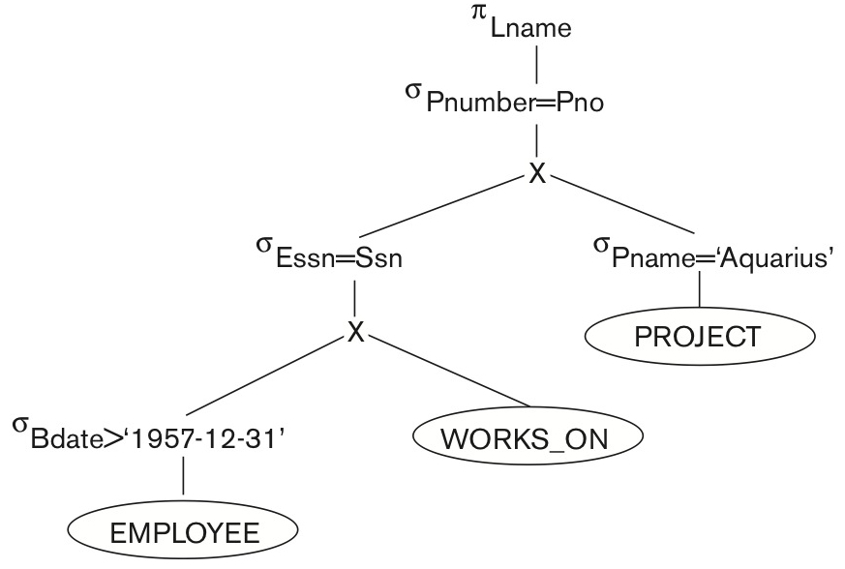
Example of Transforming a Query

Slide 19
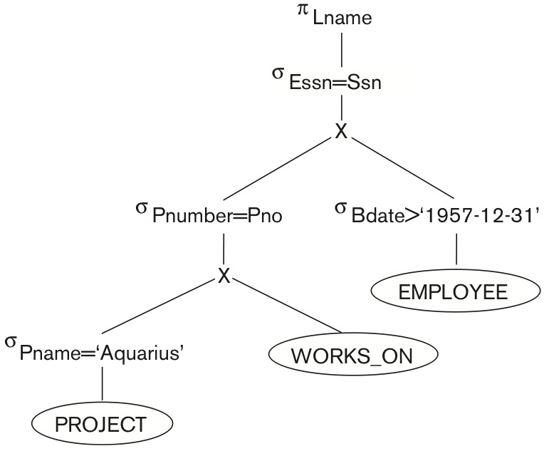
Example of Transforming a Query
Selectivity is HIGH

Slide 20
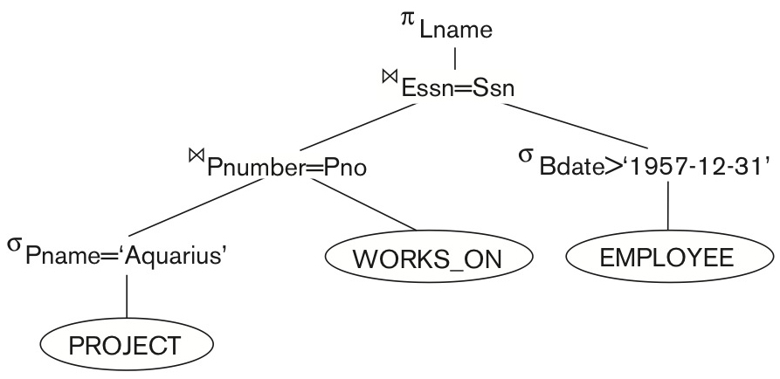
Example of Transforming a Query

Slide 21
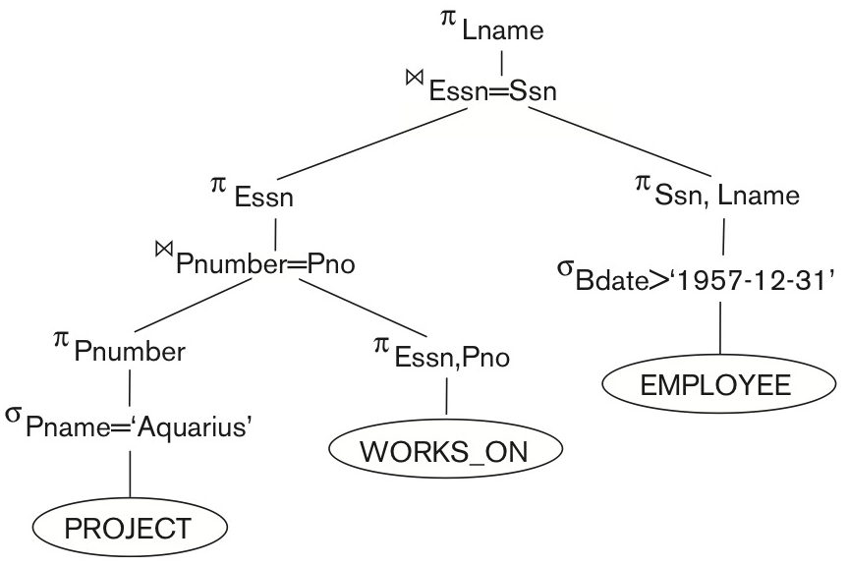
Example of Transforming a Query

Slide 22
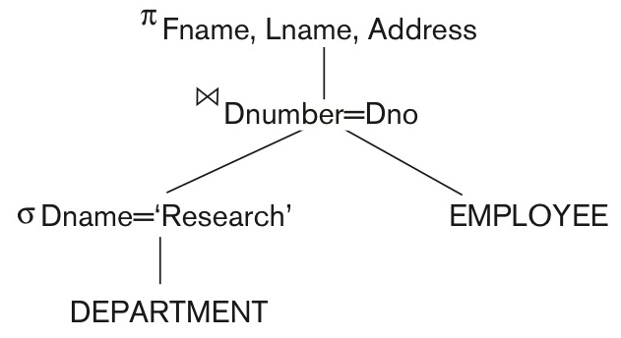
Heuristic Algebraic Optimization Algorithm
Apply SELECT and PROJECT operations before applying JOIN or binary operations because the size of the file resulting from binary operations is usually a multiplicative function of the sizes of the input files.

Slide 23
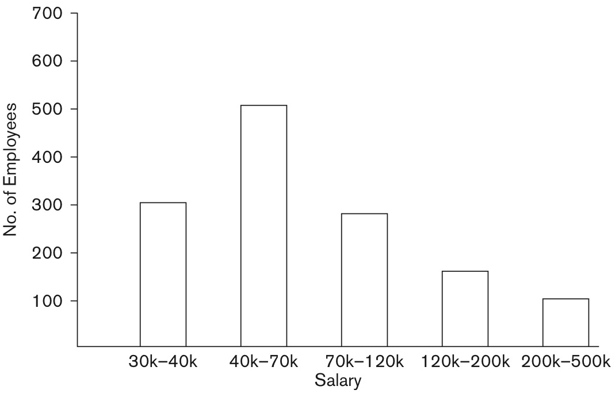
Histogram (for identifying Selectivity)

Slide 24
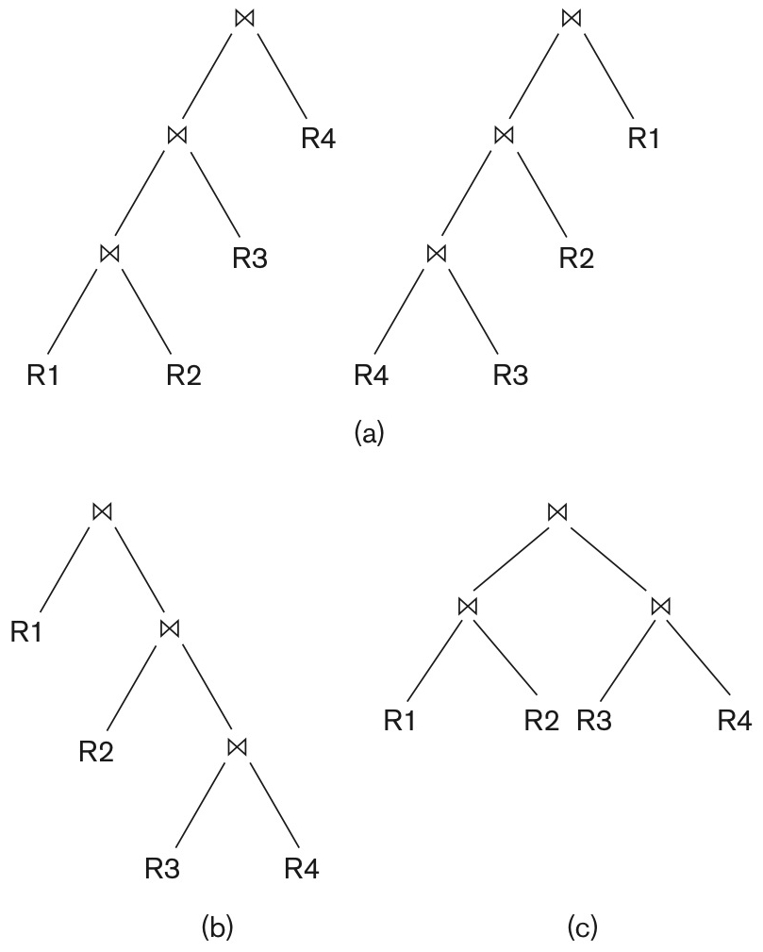
Query Tree Structure
Left-deep query tree
Right-deep query tree
Bush query tree

Slide 25
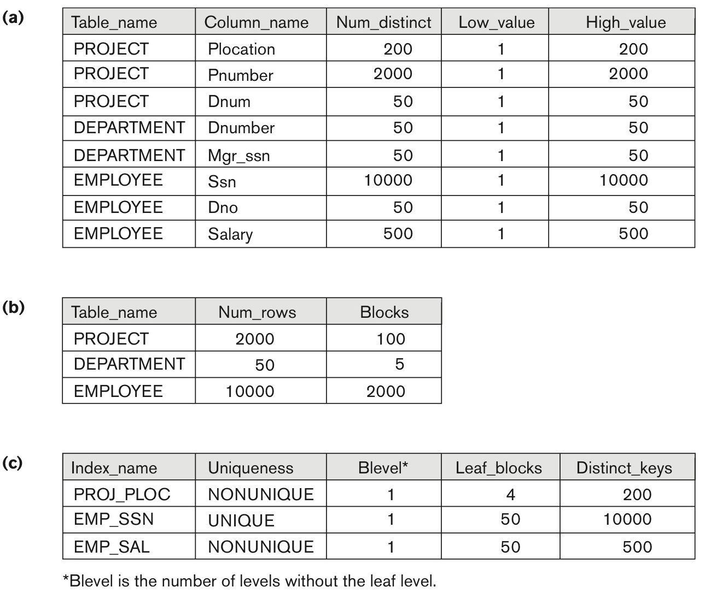
The System Catalog (Statistical Information)

Slide 26
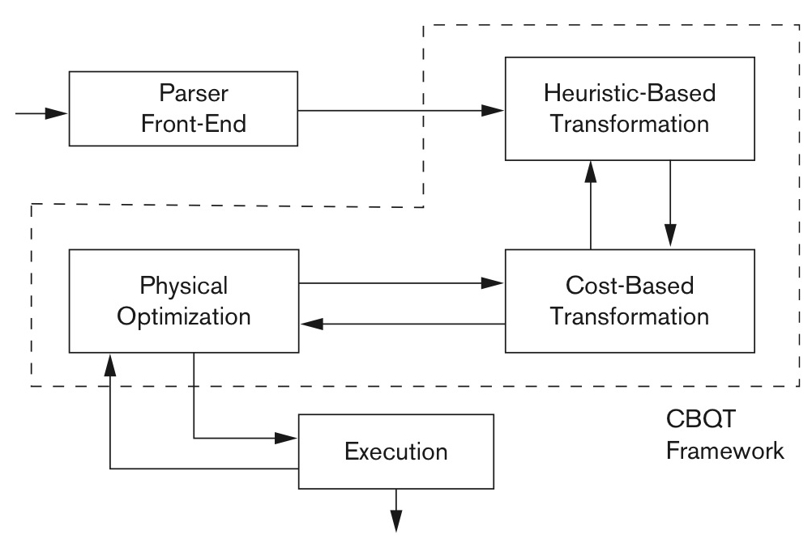
Cost-based query transformation

Slide 27
Take home message
Heuristic Algebraic Optimization Algorithm

